Slide 1
UNIT 2
Principles, Ray diagrams, parts and working, sample preparation and Forensic applications of- Simple microscope, Compound microscope, Stereo microscope, Polarized light microscope, Dark-field microscope, Comparison microscope, Fluorescent microscope, Electron microscope

Slide 2
MICROSCOPE
An instrument for viewing objects that are too small to be seen by the naked or unaided eye
Properties of a microscope A good microscope should have at least three properties: • Good Resolution • Good Contrast • Good Magnification
Good Resolution :- • Resolution power refers to the ability to produce separate images of closely placed objects. • So that they can be distinguished as two separate entities. The resolution power of- • Unaided human eye is about 0.2mm (200 µm) • Light microscope is about 0.2 µm. • Electron microscope is about 0.5 nm. Immersion Oil has a higher refractive index than air, hence, use of oil enhances the resolution power of a microscope.
Good Contrast: • Contrast is improved by staining the specimen. • When the stain bind to the cells, the contrast is increased.
Good Magnification: • Ocular lens with a magnification power of 10X. •
Objective lens- • Scanning (4X) • Low power (10X) • High power (40X) • Oil immersion (100X)
5.Total magnification of a field is the product of the magnification of objective and ocular lens: • Scanning field (40X) • Low power field (100X) • High power field (400X) • Oil immersion field (1000X)

Slide 3
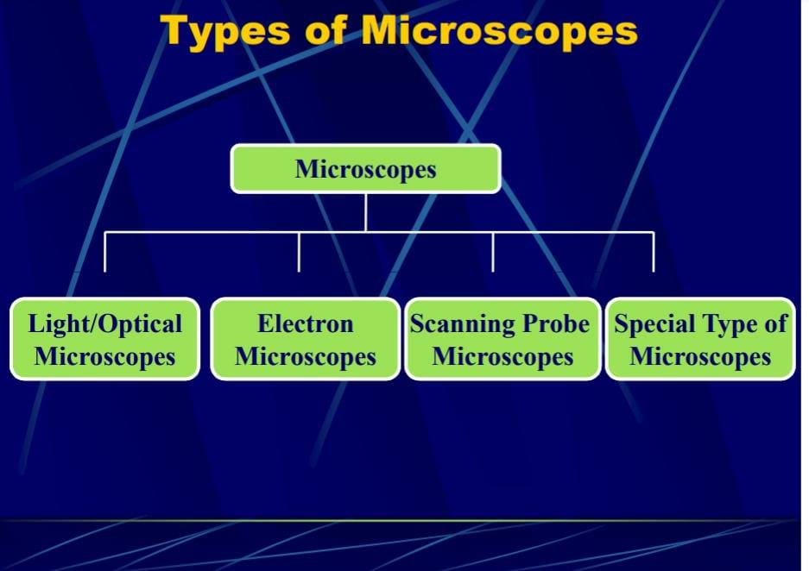

Slide 4
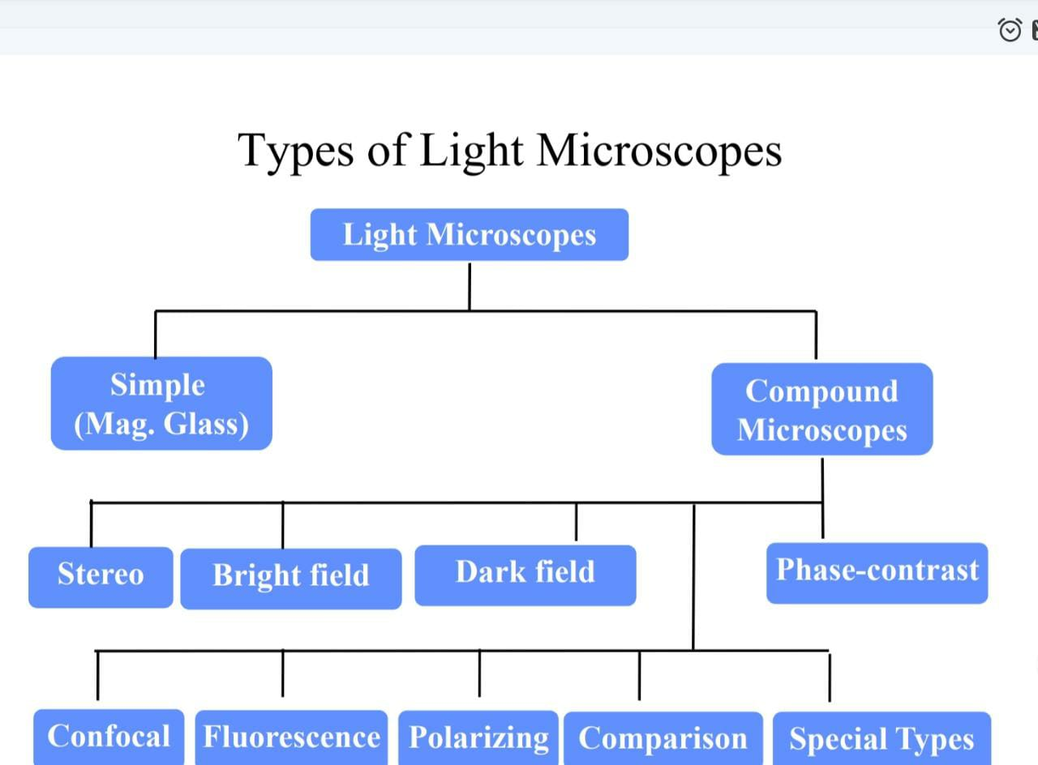

Slide 5
COMPOUND MICROSCOPE
It is a type of microscopе which utilise multiple lenses in order to collect light from the sample and then to focus the light into the eye, separate set of lenses are used. These microscopеs are more heavy, large and expensive as compared to simple microscopеs because of the increase in number of lenses used in construction. The main benefits of multiple lenses are upgraded numerical, decreased chromatic aberration and exchangeable objective lenses to modify the magnification.
PRINCIPLE: The compound microscopes works on the principle that when a tiny specimen to be magnified is placed just beyond the focus of its objective lens, a virtual, inverted and highly magnified image of the object are formed at the least distance of distinct vision from the eye held close to the eyepiece.
WORKING
Light is first emitted by the Light Source and is directed by the Condenser lens on to the Specimen.
The light from the Specimen then passes through the Objective lens.
Further light rays are passed to a Projector lens, which reverses their direction so that when the image reaches the eye it will not appear "upside-down".
Not all Microscopes have a Projector lens, so the viewer may be seeing a reverse image. In these cases, when the slide is moved, it will appear to be moving in the opposite direction to the viewer.
The light rays then travel to the Oracular lens or “Eye piece". This is often a 10X magnification lens, meaning it magnifies the magnified image an additional ten times.
The image is then projected into the Eye

Slide 6
PARTS: Eye piece, Body Tube ,Arm Stage, Course adjustment knob ,Fine adjustment knob , Base ,Nosepiece, Objective lenses, Stage Clips, Diaphragm, Illuminator
Eye piece And Body Tube. •Eyepiece is the lens through which the viewer looks to see the specimen. It usually contains a 10X or 15X power lens. The Body Tube connects the eyepiece to the objective lenses.
Objectives And Stage Clips. •Objective Lenses are the one of the most important part of a Compound Microscope. They are the closet to the specimen. A standard Microscope has three to four Objective Lenses which range from 4X to 100X. •Stage Clips are metal clips that holds the slide in a place.
Arm And Base. •The Arm connects the Body Tube to the base of the Microscope. •The Base supports the Microscope and its where Illuminator.
Illuminator And Stage. •Illuminator is the light source for a Microscope. A Compound Light Microscope uses a low voltage bulb as an Illuminator. •Stage is the flat platform where the slide is placed.
Nosepiece And Aperture. •Nosepiece is a rotating turret that holds the Objective lenses. The viewer spins the Nosepiece to select different Objective lenses.
The Aperture is the middle of the stage that allows light from the Illuminator to reach the specimen.
Condenser And Diaphragm. •A Condenser gathers and focuses light from the Illuminator onto the specimen being viewed. •Diaphragm is a five holed disk placed under the stage. Each hole is of a different diameter. By turning it, you can vary the amount of light passing through the stage opening.

Slide 7
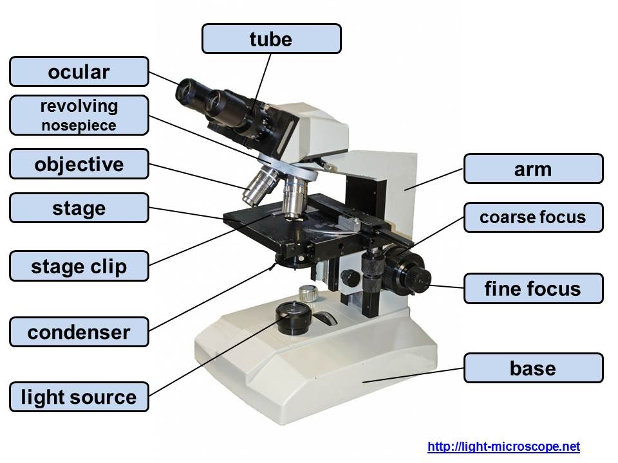
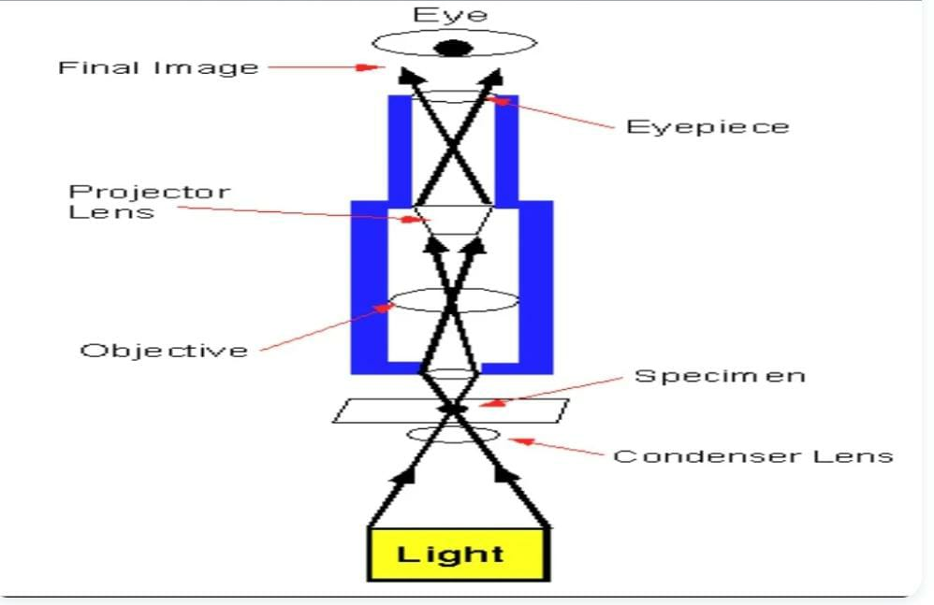
RAY DIAGRAM
PARTS OF A MICROSCOPE

Slide 8
STEREO MICROSCOPE
A stereo microscope is an optical microscope that provides a three-dimensional view of a specimen. It is also known by other names such as dissecting microscope and stereo zoom microscope. Dissecting microscope parts include separate objective lenses and eyepieces. As a result, you have two separate optical paths for each eye. The slightly different angling views to the left and right eyes produce a three-dimensional visual. Because it gives the three-dimensional view it is also called as the dissecting microscope.
PRINCIPLE: A stereo or a dissecting microscope uses reflected light from the object. It magnifies at a low power hence ideal for amplifying opaque objects. Since it uses light that naturally reflects from the specimen, it is helpful to examine solid or thick samples. The magnification of a stereo microscope ranges between 10x and 50x.
WORKING
The principle of stereo microscope depends on the 2 different paths of light from objective lens and the eyepiece. Both these lights provides a different angle of viewing in which the bottom light is used for viewing the samples while the top light is used during dissecting.
The two eyepieces enables in this microscope enables a comforting view of the sample from different angles simultaneously.
It also consists of a digital camera that is used for viewing the images of the samples in the computer for a close observation. The image produced is a little larger than normal and is recorded.
The dissecting microscope has two magnifications known as Fixed magnification and Zoom magnification. Fixed magnification is used in eyepiece to provide a degree of magnification while Zoom magnification offers different magnifications at different ranges.

Slide 9
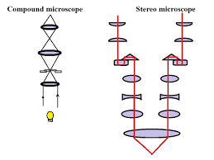
RAY DIAGRAM

Slide 10
POLARIZED LIGHT MICROSCOPE
Polarized Light: Light is an electromagnetic wave. Although light waves can vibrate in all directions, in general, they are described as vibrating in two directions at right angles to each other. Any light which vibrates in more than one direction is called ‘unpolarised light’; whereas, a light wave that vibrates in a single direction is called ‘polarised light’. The human eye is not sensitive to the direction of vibration of light.
Converting Non-Polarised to Polarized Light: Polarized light microscopes work by converting unpolarized light to polarized light. One way in which this can be achieved is by absorption of light vibrational movement in one specific direction. This can be done by certain natural minerals, including tourmaline, or by synthetic films that perform the same function.
The device which selects the plane-polarized from natural or unpolarized light is called a polarizer.
PRINCIPLE: In a polarized light microscope, a polarizer intervenes between the light source and the sample. Thus, the polarized light source is converted into plane-polarized light before it hits the sample
PARTS
Polarizers: Polarizing filters are the most critical part of the polarized light microscope. There are usually two polarizing filters: the polarizer and the analyzer. The polarizer is located below the specimen stage and can be rotated through 360°. It helps to polarize the light which falls on the specimen. The analyzer is placed above the objective and may be rotatable in some cases. It combines the different rays emerging from the specimen to generate the final image.

Slide 11
Specialized Stage: This is the specimen stage and it can rotate 360° to facilitate the correct orientation of the specimen with the objective plane. In several stages, a Vernier scale is also provided to provide an accuracy of 0.1° in the rotational angle of the stage.
Strain-Free Objectives: Any stress on the objective during installation can lead to a change in the optical properties of the lens which can reduce the performance. Strain can also be introduced if the lens is mounted too tightly on the frame.
Revolving Nosepiece: As the stage and objectives can revolve in many polarizing microscopes, a revolving nosepiece is also often fitted such that the specimen can be visualized in the center of the view field even if the stage is rotated.
Compensator and Retardation Plates: Several polarization microscopes have compensators and/or retardation plates. This is placed between the crossed polarizers to increase the contrast of the image quality. Thus, polarizing microscopes are being used to increase the image contrast to visualize many anisotropic sub-cellular structures.
WORKING
In a polarized light microscope, a polarizer intervenes between the light source and the sample. Thus, the polarized light source is converted into plane-polarized light before it hits the sample. This polarized light falls on a doubly refracting specimen which generates two wave components that are at right angles to each other. These two waves are called ordinary and extraordinary light rays.
The waves pass through the specimen in different phases. They are then combined using constructive and destructive interference, by an analyzer. This leads to the final generation of a high-contrast image.
FORENSIC APPLICATION
Hair Sample: Natural Light Hair Sample: Polarized Light can provide information about the shape, color, and size of minerals and it is used to identify hair, human-made fibers and paint.

Slide 12
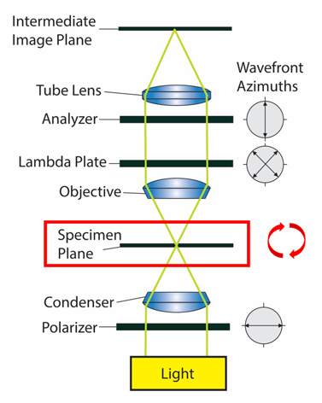
RAY DIAGRAM -POLARIZED LIGHT MICROSCOPY

Slide 13
FLOURESCENCE MICROSCOPE
PRINCIPLE: Fluorescence microscopy is a type of light microscope that works on the principle of fluorescence. A substance is said to be fluorescent when it absorbs the energy of invisible shorter wavelength radiation (such as UV light 100-400nm) and emits longer wavelength radiation of visible light (such as green or red light-400nm-800nm)
PARTS
Light source: Xenon arc lamp or mercury-vapor lamp are common; power LED and lasers are used in more advanced forms.
A set of optical filters: Optical filters include a set of a compatible excitation filter, emission filter, and dichroic beam splitter;
An excitation filter selects the wavelengths to excite a particular dye within the specimen.
A dichroic beam splitter/ dichroic mirror reflects light in the excitation band and transmit light in the emission band, enabling the classic epifluorescence incident light illumination.
An emission filter serves as a kind of quality control by letting only the wavelengths of interest emitted by the fluorophore pass through.
Darkfield condenser: It provides a black background against which the fluorescent objects glow.

Slide 14
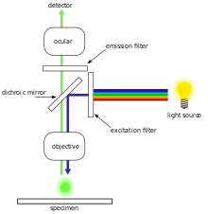
WORKING
RAY DIAGRAM
To observe the sample through a fluorescence microscope, it should be first labeled with a fluorescent dye known as a fluorophore.
Higher energy light shorter wavelength of lights (UV rays or blue light) generated from mercury vapor arc lamp passes through the excitation filter which allows only the short wavelength of light to pass through and removes all other non-specific wavelengths of light.
The filtered light is reflected by the dichroic filter and falls on the sample. The fluorochrome absorbs shorter wavelength rays and emits rays of longer wavelength (lower energy) that passes through the emission filter. The emission filter blocks (suppresses) any residual excitation light and passes the desired longer emission wavelengths to the detector.
Thus the microscope forms glowing images of the fluorochrome-labeled microorganisms against a dark background.
To the observer, the background is dark, as there is no visible light and only the labelled specimen (cells, microorganisms etc.) appear bright (fluoresce).

Slide 15
COMPARISON MICROSCOPE
PRINCIPLE: A comparison microscope is a tool used to examine simultaneous specimens. It comprises of two microscopеs linked by an optical bridge, which results in a split view window allowing two separate objects to be viewed consecutively. This prevents the viewer having to depend on memory when associating two objects under a conventional microscopе. The modern apparatus has various optical, mechanical and electronic refinements, including fiber optic illumination, video capabilities, digital imaging, automatic exposure for conventional photography, etc.
The comparison microscope is a key tool for firearm and toolmark examination.
WORKING: Comparison Microscope provides a side by side comparison of specimens Structure consists of 2 compound microscopes combined into one unit.
Designed to use a bridge incorporating a series of mirrors and lenses to join 2 independent objective lenses into a singular binocular unit.
Viewer will see a circular field divided into 2 equal parts by a thin line.
The specimen on the left will be seen in the left half of the field of view and the specimen on the right will be seen in the right half of the field of view.

Slide 16
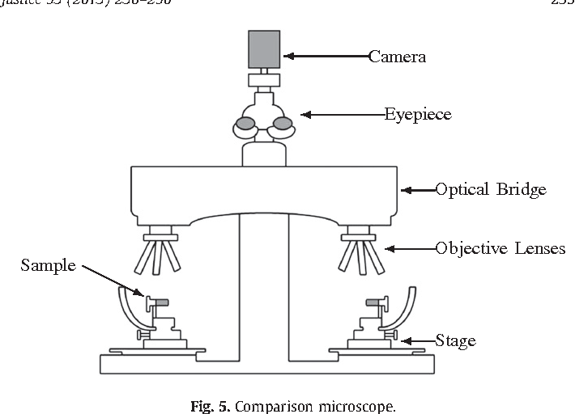

Slide 17
DARK- FIELD MICROSCOPE
PRINCIPLE: The dark ground microscope creates a contrast between the object and the surrounding field, such that, the background is dark and the object is bright. The objective and the ocular lenses used in the dark ground microscope are the same as in the ordinary light microscope, however, a special condenser is used, which prevents the transmitted light from directly illuminating the specimen. Only oblique scattered light reaches the specimen and passes onto the lens system causing the object to appear bright against a dark background.
WORKING
A dark field microscope is arranged so that the light source is blocked off, causing light to scatter as it hits the specimen.
This is ideal for making objects with refractive values similar to the background appear bright against a dark background.
When light hits an object, rays are scattered in all directions. The design of the dark field microscope is such that it removes the dispersed light, so that only the scattered beams hit the sample.
The introduction of a condenser below the stage ensures that these light rays will hit the specimen at different angles, rather than as a direct light source above/below the object.
The result is a “cone of light” where rays are diffracted, refracted off the object, ultimately, allowing the individual to view a specimen in dark field.

Slide 18
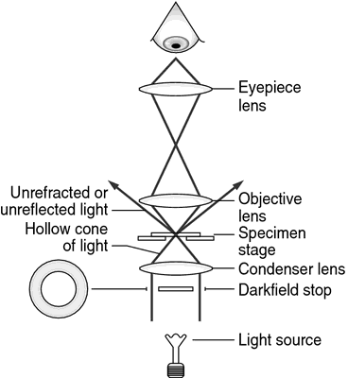
RAY DIAGRAM- DARK FIELD MICROSCOPE
Darkfield is used to study marine organisms such as algae, plankton, diatoms, insects, fibers, hairs, yeast and protozoa as well as some minerals and crystals, thin polymers and some ceramics.
It is more useful in examining external details, such as outlines, edges, grain boundaries and surface defects than internal structure.

Slide 19
ELECTRON MICROSCOPE
An electron microscope uses an ‘electron beam’ to produce the image of the object and magnification is obtained by ‘electromagnetic fields’; unlike light or optical microscopes, in which ‘light waves’ are used to produce the image and magnification is obtained by a system of ‘optical lenses’.
That is why, despite its smaller numerical aperture, an electron microscope can resolve objects as small as 0.001µ, as compared to 0.2µ by a light microscope. Thus, the resolving power of an electron microscope is 200 times greater than that of a light microscope. It produces useful magnification up to X 400,000, as compared to X 2000 in a light microscope. Thus, the useful magnification is 200 times greater in an electron microscope than that in a light microscope.
PRINCIPLE: The electron microscope uses an electron beam to create an image, with electromagnets acting as lenses. The limit of resolution is improved by a factor of 1000 over the light microscope.
Transmission Electron Microscopy is particularly meant to study thin specimen which allows the incident electrons to traverse through after due interactions. The Transmission Electron Microscope (TEM) produces a two-dimensional (2D) image of an ultra-thin section by capturing electrons that have passed through the specimen. The Transmission Electron Microscope is useful for studying a cell's interior and its ultra-structure.
A Scanning Electron Microscope (SEM) used to make a three-dimensional image of the specimen surface. SEM requires low kinetic energy electrons which need not penetrate deep inside the sample, instead interact on the surface up to a few nm of the depth. The electron source is tungsten filament

Slide 20
WORKING
The basic steps involved in all EMs:
A stream of high voltage electrons (usually 5-100 KeV) is formed by the Electron Source (usually a heated tungsten or field emission filament) and accelerated in a vacuum toward the specimen using a positive electrical potential.
This stream is confined and focused using metal apertures and magnetic lenses into a thin, focused, monochromatic beam.
This beam is focused onto the sample using a magnetic lens.
Interactions occur inside the irradiated sample, affecting the electron beam.
These interactions and effects are detected and transformed into an image.

Slide 21
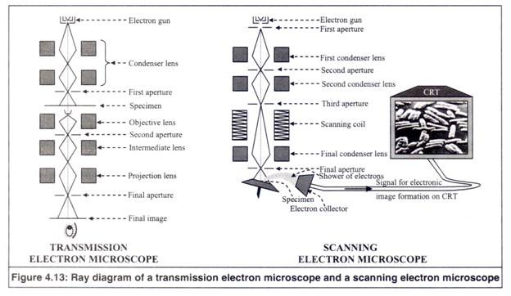

Slide 22
FORENSIC APPLICATIONS
Microscopic examinations and analysis of evidences provide valuable results in CSI. Some of them are:
Gunshot residue analysis
Firearms identification – bullet marking comparison
Investigation of gemstones and jewellery
Examination of paint particles and fibers
Filament bulb investigation at traffic signals
Handwriting and print examination/forgery
Counterfeit bank notes
Trace comparison
Examination of non-conducting materials
High resolution surface imaging

